Slide 1

Project Phase-2
Department of Artificial Intelligence
Group - 10
Semester-8
Malware detection System using Deep Learning
Project Mentor: Prof Achamma Thomas
Group member:
Abhiroop Sarkar (16)
Prateek Dutta (47)
Adnan Quraishee (22)
Saurabh Barse (54)

Slide 2
Malware ..
Malware is one of the most serious security threats on the Internet today. The malware industry continues to be a well-organized, well-funded market dedicated to evading traditional security measures.
Once a computer is infected by malware, criminals can hurt consumers and enterprises in many ways.

Slide 3
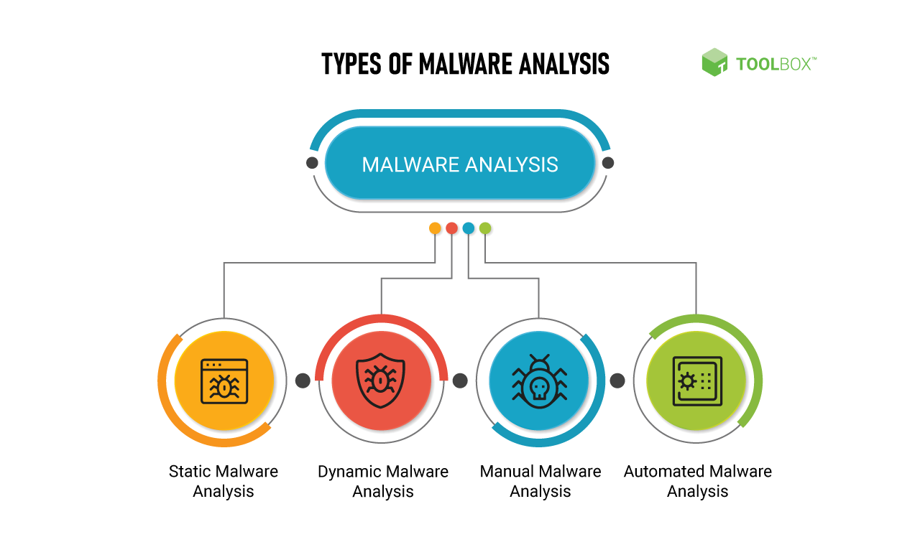

Slide 4
Types of Malware
Types | Purpose | Example
Spyware | Spyware collects its victims' user activity data without their knowledge. | DarkHotel
Adware | Adwares serves unwanted advertisements. It generates revenue for its developers by automatically generating adverts on your screen, usually within a web browser. | Fireball
Trojan | Trojan disguises itself as a desirable code. It misleads users of its true intent | Emotet
Ransomware | Ransomwares purpose is to disable its victims' access to data until the ransom is paid. | RYUK
Rootkits | Rootkits gives the remote control of Victims Device. | Zacinlo
Keyloggers | Keylogger is a type of surveillance technology used to monitor and record each keystroke on a specific computer. | Olympic Vision
Wiper Malware | Wiper Malware is built with the sole purpose to erase the victims data beyond recoverability. | WhisperGate
Bots | Bots launch a broad flood of attacks. Malware bots and internet bots can be programmed/hacked to break into user accounts, scan the internet for contact information, to send spam, or perform other harmful acts. | Echobot
Mobile Malware | These infect mobile devices. It targets mobile phones or wireless-enabled Personal digital assistants, by causing the collapse of the system and loss or leakage of confidential information. | Triada
Fileless Malware | It makes changes to the files native of the OS. It does not rely on files and leaves no footprint, making it challenging to detect and remove. | Astaroth
Worms | Worms spread throughout the network by replicating itself. | Stuxnet

Slide 5
Why Deep Learning
One of the key advantages of machine-based approaches is that they can adapt to new and previously unseen malware threats, whereas traditional signature-based approaches can only detect known malware variants.
Models can be trained on large datasets of both benign and malicious software to learn the characteristics that distinguish malware from legitimate software, allowing them to identify new, unknown malware based on these learned patterns.
Deep learning models are particularly well-suited for identifying patterns and features in complex, high-dimensional data, such as the raw binary code of software applications, which can be a challenging task for traditional machine learning algorithms.
These networks learn to extract relevant features from the binary code, such as opcode sequences and control flow graphs, that can be used to distinguish between malicious and legitimate software.
Once trained, these models can be used to classify new, previously unseen software as either malware or benign.

Slide 6
Why Deep Learning
Nowadays deep learning has dominated the various computer vision tasks.
Not only these deep learning techniques enabled rapid progress in this competition, but even surpassed human performance in many of them.
One of these tasks is Image Classification. Unlike more traditional methods of machine learning techniques, deep learning classifiers are trained through feature learning rather than task-specific algorithms.

Slide 7
Dataset
We are using EMBER (Elastic Malware Benchmark for Empowering Researchers) dataset for our project and research purpose.
The EMBER dataset is a collection of features from PE (Portable Executable) files that serve as a benchmark dataset for researchers.
The EMBER2017 dataset contained features from 1.1 million PE files scanned in or before 2017 and the EMBER2018 dataset contains features from 1 million PE files scanned in or before 2018.
The dataset includes features extracted from 1.1M binary files: 900K training samples (300K malicious, 300K benign, 300K unlabeled) and 200K test samples (100K malicious, 100K benign).

Slide 8
About Dataset
The EMBER dataset consists of a collection of JSON lines files, where each line contains a single JSON object. Each object includes the following types in data:
• The sha256 hash of the original file as a unique identifier;
• Coarse time information (month resolution) that establishes an estimate of when the file was first seen;
• A label, which may be 0 for benign, 1 for malicious or -1 for unlabeled; and
• Eight groups of raw features that include both parsed values as well as format-agnostic histograms.

Slide 9
Features Dataset
Column name: Version Dependencies
Type: number
Column name: label
Type: 0 ("goodware") or 1 (malware)
Column name: OS Resource allocations
Type: number
Column name: Critical System Access
Type: 0(“Yes”) or 1 (“No”)
Column name: sha256 (To check validity of file)
Type: string

Slide 10
THANK YOU
GitHub Repository:- https://github.com/project2sem8ghrceAI

